Slide 1
Guide to Programming with Python
Chapter Two
Types, Variables, and Simple I/O: The Useless Trivia Program

Slide 2
Objectives
Use triple-quoted strings and escape sequences
Make programs do math
Store data in the computer’s memory
Use variables to access and manipulate that data
Get input from users to create interactive programs
Guide to Programming with Python

Slide 3
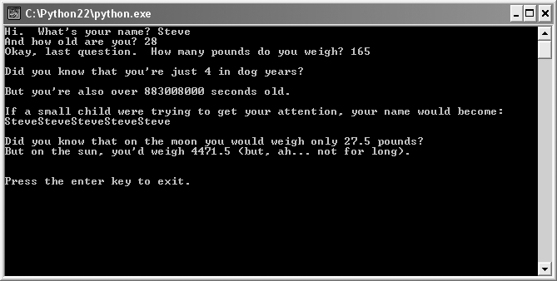
The Useless Trivia Program
Figure 2.1: Sample run of the Useless Trivia program
Whoa! Steve might think about a diet before he visits the sun.
Guide to Programming with Python

Slide 4
Using Quotes with Strings
Can create a single string that's paragraphs long
Can format text of string in a specific manner
Can use quotes to create long string or to format
Guide to Programming with Python

Slide 5
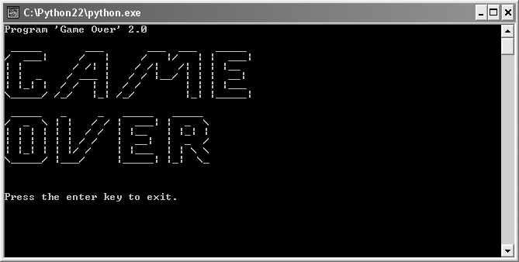
The Game Over 2.0 Program
Figure 2.2: Sample run of the Game Over 2.0 program
Ah, the game is really over.
Guide to Programming with Python

Slide 6
Using Quotes
Using quotes inside strings
  Define with either single (') or double quotes (")
    'Game Over' or "Game Over"
  Define with one type, use other type in string
    "Program 'Game Over' 2.0"
Triple-quoted strings can span multiple lines
  """
  I am a
  triple-quoted string
  """
Line-continuation character \
Guide to Programming with Python

Slide 7
Using Escape Sequences with Strings
Escape sequence: Set of characters that allow you to insert special characters into a string
  Backslash followed by another character
  e.g. \n
  Simple to use
Guide to Programming with Python

Slide 8
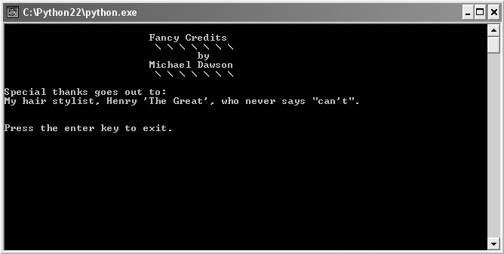
The Fancy Credits Program
Figure 2.3: Sample run of the Fancy Credits program
So many people to thank, so many escape sequences
Guide to Programming with Python

Slide 9
Escape Sequences
System bell
  print "\a"
Tab
  print "\t\t\tFancy Credits"
Backslash
  print "\t\t\t \\ \\ \\ \\ \\ \\ \\"
Newline
  print "\nSpecial thanks goes out to:"
Quote
  print "My hair stylist, Henry \'The Great\', who never says \"can\'t\"."
Guide to Programming with Python

Slide 10
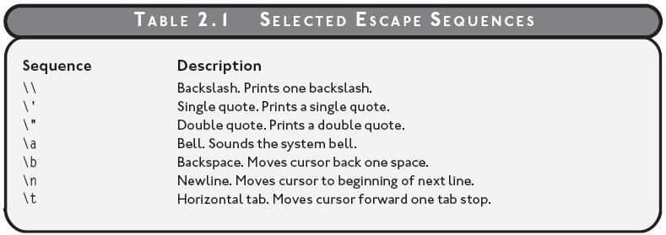
Escape Sequences (continued)
Table 2.1: Selected escape sequences
Guide to Programming with Python

Slide 11
Concatenating and Repeating Strings
Can combine two separate strings into larger one
Can repeat a single string multiple times
Guide to Programming with Python

Slide 12
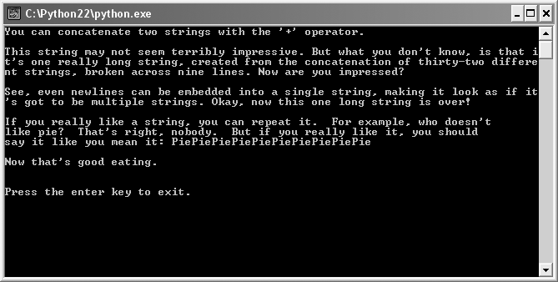
The Silly Strings Program
Figure 2.4: Sample run of the Silly Strings program
Strings appear differently than in the program code.
Guide to Programming with Python

Slide 13
Concatenating Strings
String concatenation: Joining together of two strings to form a new string
When used with string operands, + is the string concatenation operator
  "concat" + "enate"
Suppressing a Newline
  When used at the end of print statement, comma suppresses newline
  print "No newline after this string",
Guide to Programming with Python

Slide 14
Repeating String
Multiple concatenations
  When used with strings, * creates a new string by concatenating a string a specified number of times
  Like “multiplying” a string
  "Pie" * 10 creates new string "PiePiePiePiePiePiePiePiePiePie"
Guide to Programming with Python

Slide 15
Working with Numbers
Can work with numbers as easily as with strings
Need to represent numbers in programs
  Score in space shooter game
  Account balance in personal finance program
Python can represent different types of numbers
Guide to Programming with Python

Slide 16
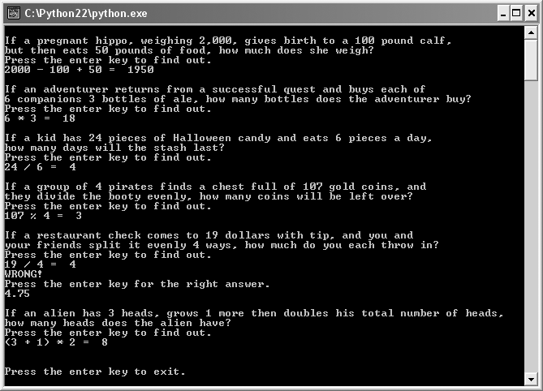
The Word Problems Program
Figure 2.5: Sample run of the Word Problems program
With Python, you can keep track of a pregnant hippo’s weight.
Guide to Programming with Python

Slide 17
Numeric Types
Type: Represents the kind of value; determines how the value can be used
Two common numeric types
  Integers: Numbers without a fractional part
  1, 0, 27, -100
  Floating-Point Numbers (or Floats): Numbers with a fractional part
  2.376, -99.1, 1.0
Guide to Programming with Python

Slide 18
Mathematical Operators
Addition and Subtraction
  print 2000 - 100 + 50 displays 1950
Integer Division
  print 24 / 6 displays 4
  But print 19 / 4 displays 4 as well
  Result of integer division always integer
Floating-Point Division
  print 19.0 / 4 displays 4.75
  When at least one number is a float, result is a float
Modulus (remainder of integer division)
  print 107 % 4 displays 3
Guide to Programming with Python

Slide 19
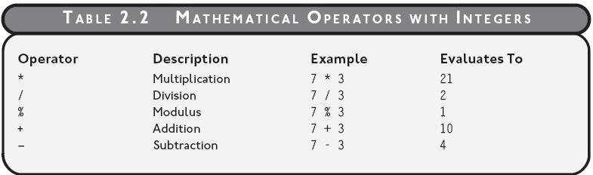
Mathematical Operators (continued)
Table 2.2: Mathematical operators with integers
Guide to Programming with Python

Slide 20
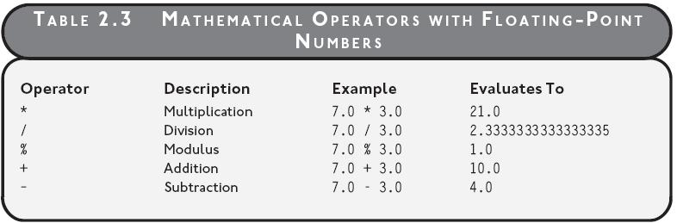
Mathematical Operators (continued)
Table 2.3: Mathematical operators with floats
Guide to Programming with Python

Slide 21
Understanding Variables
Variable: Represents a value; provides way to get at information in computer memory
Variables allow you to store and manipulate information
You can create variables to organize and access this information
Guide to Programming with Python

Slide 22
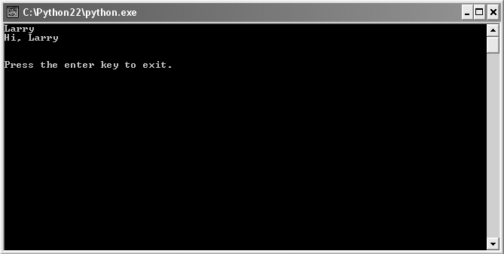
The Greeter Program
Figure 2.6: Sample run of the Greeter program
Using a variable for the name
Guide to Programming with Python

Slide 23
Creating Variables
Assignment statement: Assigns a value to a variable; creates variable if necessary
name = "Larry"
  Stores string "Larry" in computer memory
  Creates variable name
  Assigns value so that name refers to "Larry"
Guide to Programming with Python

Slide 24
Using Variables
Use variable where you want value it represents
print name or print "Larry"
Both display Larry
print "Hi, " + name or print "Hi, Larry"
Both display Hi, Larry
Guide to Programming with Python

Slide 25
Naming Variables
Rules for legal variable names
  Can contain only numbers, letters, and underscores
  Can’t start with a number
  Can’t be a keyword
Keyword: Built-in word with special meaning
Legal Names
  velocity, player2, max_health
Illegal Names
  ?again, 2nd_player, print
Guide to Programming with Python

Slide 26
Naming Variables (continued)
Guidelines for good variable names
  Choose descriptive names; score instead of s
  Be consistent; high_score or highScore
  Follow traditions; Names that begin with underscore have special meaning
  Keep the length in check personal_checking_account_balance - too long?
  Self-documenting code: Code written so that it’s easy to understand, independent of any comments
Guide to Programming with Python

Slide 27
Getting User Input
Variables important for
  Getting user input
  Storing user input
  Manipulating user input
Guide to Programming with Python

Slide 28

The Personal Greeter Program
Figure 2.7: Sample run of the Personal Greeter program
name is assigned a value based on what the user enters.
Guide to Programming with Python

Slide 29
Getting User Input
Function: A named collection of programming code that can receive values, do some work, and return values
Argument: Value passed to a function
Return value: Value returned from a function upon completion
Function is like a pizzeria
  Make a call
  Provide information (like pepperoni)
  Get something back (like a hot pepperoni pizza)
Guide to Programming with Python

Slide 30
Getting User Input (continued)
raw_input() function
  Prompts the user for text input
  Returns what the user entered as a string
name = raw_input("Hi. What's your name? ")
  Uses argument "Hi. What's your name? " to prompt user
  Returns what user entered as a string
  In assignment statement, name gets returned string
Guide to Programming with Python

Slide 31
Using String Methods
String methods allow you to do many things, including:
  Create new strings from old ones
  Create string that’s all-capital-letters version original
  Create new string from original, based on letter substitutions
Guide to Programming with Python

Slide 32
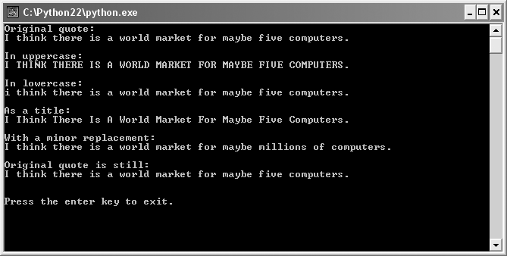
The Quotation Manipulation Program
Figure 2.8: Sample run of the Quotation Manipulation program
The slightly low guess is printed several times with string methods.
Guide to Programming with Python

Slide 33
String Methods
Method: A function that an object has
Use dot notation to call (or invoke) a method
  Use variable name for object, followed by dot, followed by method name and parentheses
  an_object.a_method()
Strings have methods that can return new strings
Guide to Programming with Python

Slide 34
String Methods (continued)
quote = "I think there is a world market for maybe five computers."
  print quote.upper()
  I THINK THERE IS A WORLD MARKET FOR MAYBE FIVE COMPUTERS.
  print quote.lower()
  i think there is a world market for maybe five computers.
  print quote.title()
  I Think There Is A World Market For Maybe Five Computers.
  print quote.replace("five", "millions of")
  I think there is a world market for millions of computers.
Original string unchanged
  print quote
  I think there is a world market for maybe five computers.
Guide to Programming with Python

Slide 35
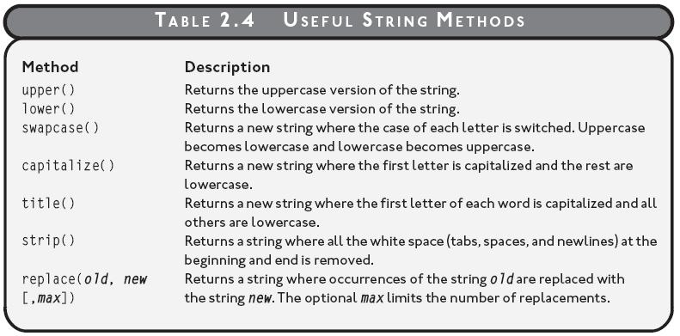
String Methods (continued)
Table 2.4: Useful string methods
Guide to Programming with Python

Slide 36
Using the Right Types
Important to know which data types are available
Equally important to know how to work with them
If not, might end up with program that produces unintended results
Guide to Programming with Python

Slide 37
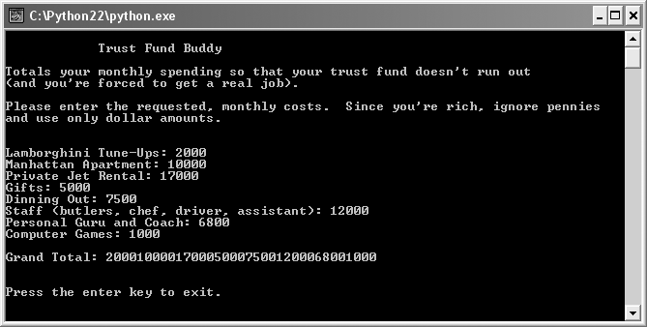
The Trust Fund Buddy–Bad Program
Figure 2.9: Sample run of the Trust Fund Buddy-Bad program
The monthly total should be high, but not that high.
Guide to Programming with Python

Slide 38
Logical Errors
Logical Error: An error that doesn’t cause a program to crash, but instead produces unintended results
Program output that looks like very large number: 200001000017000500075001200068001000
Remember, raw_input() returns a string, so program is not adding numbers, but concatenating strings
Guide to Programming with Python

Slide 39
Logical Errors (continued)
car = raw_input("Lamborghini Tune-Ups: ")
rent = raw_input("Manhattan Apartment: ")
jet = raw_input("Private Jet Rental: ")
gifts = raw_input("Gifts: ")
food = raw_input("Dining Out: ")
staff = raw_input("Staff (butlers, chef, driver, assistant): ")
guru = raw_input("Personal Guru and Coach: ")
games = raw_input("Computer Games: ")
total = car + rent + jet + gifts + food + staff + guru + games
car, rent, jet, gifts, food, staff, guru, games are strings
total is concatenation of all strings
Guide to Programming with Python

Slide 40
Converting Values
Can convert one type of value to another
Use built-in functions
Solution to Trust Fund Buddy–Bad program
Guide to Programming with Python

Slide 41
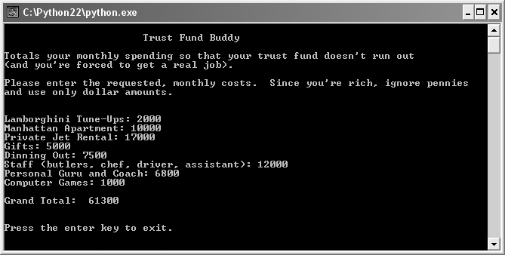
The Trust Fund Buddy–Good Program
Figure 2.10: Sample run of the Trust Fund Buddy-Good program
Now the total is right.
Guide to Programming with Python

Slide 42
Converting Types
int() function converts a value to an integer
  car = raw_input("Lamborghini Tune-Ups: ")
  car = int(car)
Can nest multiple function calls
  rent = int(raw_input("Manhattan Apartment: "))
Guide to Programming with Python

Slide 43
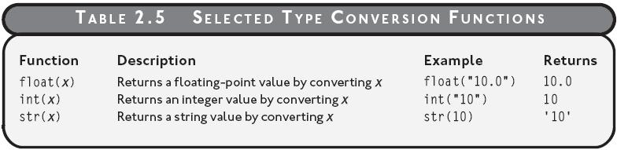
Converting Types (continued)
Table 2.5: Selected type conversion functions
Guide to Programming with Python

Slide 44
Augmented Assignment Operators
Common to assign a value to a variable based on its original value
  For example, increment value of variable
Augmented assignment operators provide condensed syntax
  Original: score = score + 1
  Augmented: score += 1
Guide to Programming with Python

Slide 45
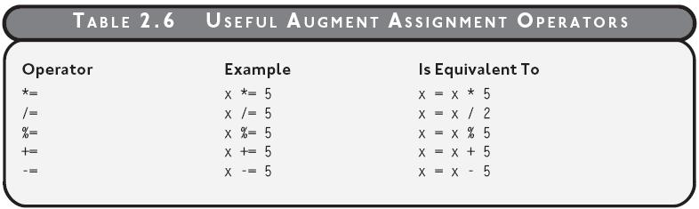
Augmented Assignment Operators (continued)
Table 2.6: Useful augmented assignment operators
Guide to Programming with Python

Slide 46
Printing Multiple Values
To print multiple values in single print statement, separate values by commas
  print "\nGrand Total: ", total
Guide to Programming with Python

Slide 47
Summary
String can be defined with either single or double quotes
Tripled-quoted strings, defined by three opening and closing quotes, can span multiple lines
An escape sequence is a set of characters that allow you to insert special characters into a string
String concatenation is the joining together of two strings to form a new string
Integers, whole numbers with no decimal part, and floats, numbers with a decimal part, are two numeric types
Guide to Programming with Python

Slide 48
Summary (continued)
Result of integer division is always an integer while result of floating-point division is always a float
A variable represents a value and provides way to get at information in computer memory
An assignment statement assigns a value to a variable and creates variable if necessary
A function is a named collection of programming code that can receive values, do some work, and return values
The raw_input() function prompts the user for input and returns what the user entered as a string
Guide to Programming with Python

Slide 49
Summary (continued)
A method is a function that an object has
Strings have methods that can return new strings
A logical error produces unintended results
Python has functions for converting values to an integer, a float, or a string
Augmented assignment operators provide condensed syntax for changing the value of a variable based on its original value
Guide to Programming with Python

